Slide 1
RAILWAYS ENQUIRY SYSTEM
DATABASE MANAGEMENT SYSTEMS AND APPLICATIONS LAB – MINI PROJECT
TEAM MEMBERS:
SAI VISHVESH V 205002079
SAILESH R 205002080
VISHAL K 205002126

Slide 2
PROBLEM STATEMENT:
A RAILWAY ENQUIRY SYSTEM IS MADE USING TKINTER AS THE GUI IN PYTHON, WHICH HELPS THE USER TO
GET INFORMATION OF TRAINS SUITABLE FOR HIS/HER REQUIREMENTS BY RETRIEVING THE STORED INFORMATION OF THE AVAILABILITY OF TRAINS IN THE DATABASE.
THE DATABASE HAS BEEN DESIGNED USING SQL SERVER MANAGEMENT STUDIO.
REAL TIME APPLICATION:
THIS WINDOW BASED ENQUIRING APPLICATION IS HELPFUL IN GETTING THE ESSENTIAL DETAILS OF TRAINS ACCORDING TO THE REQUIREMENTS OF THE USER. THIS PROJECT HAS BEEN MODELLED BASED ON IRCTC (INDIAN RAILWAY CATERING AND TOURISM CORPORATION).
THE REQUIREMENTS FOR DESIGNING THE ABOVE PROJECT IS THE DETAILS OF TRAINS RUNNING THROUGH DIFFERENT STATIONS, THE WEEKLY SCHEDULE OF TRAINS,THE TICKET FARE AND FINALLY THE USER LOGIN INFORMATION.

Slide 3
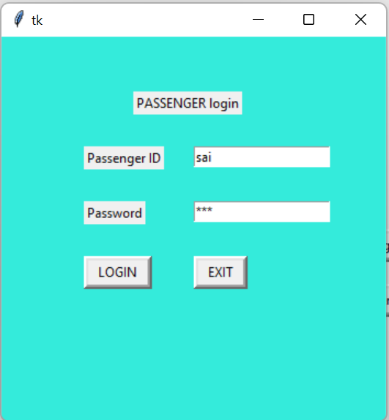
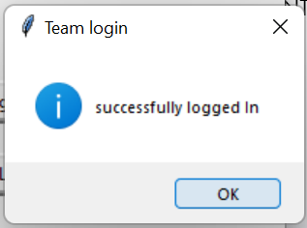
CHALLENGES FACED DURING DESIGNING AND RETRIEVING INFORMATION FROM THE DATABASE:
INSERTION ANOMALY: WHILE AN USER TRIES TO REGISTER WITH SAME USER DETAILS WHICH ALREADY EXISTS IN THE DATABASE WE COME ACROSS AN INSERTION ANOMALY, HERE WE RAISE AN ERROR AND PROMPT THE USER TO USE DIFFERENT LOGIN CREDENTIALS.
EXISTING LOGIN CREDENTIALS

Slide 4
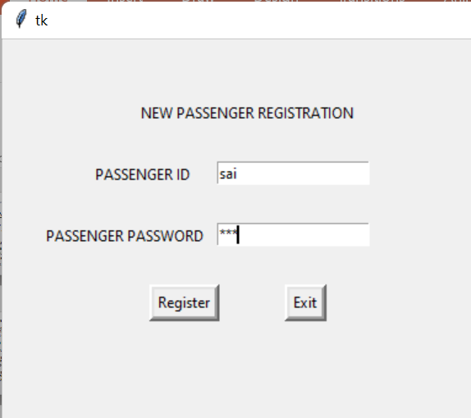
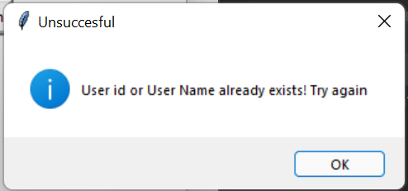
DELETION ANOMALY:
THE TABLE TRAIN WHICH HAS train_id AS A PRIMARY KEY, WHICH IS ALSO THE FOREIGN KEY FOR OTHER TABLES CANNOT BE DELETED AND THE BELOW ERROR POPS UP DUE TO A DELETION ANOMALY.

Slide 5
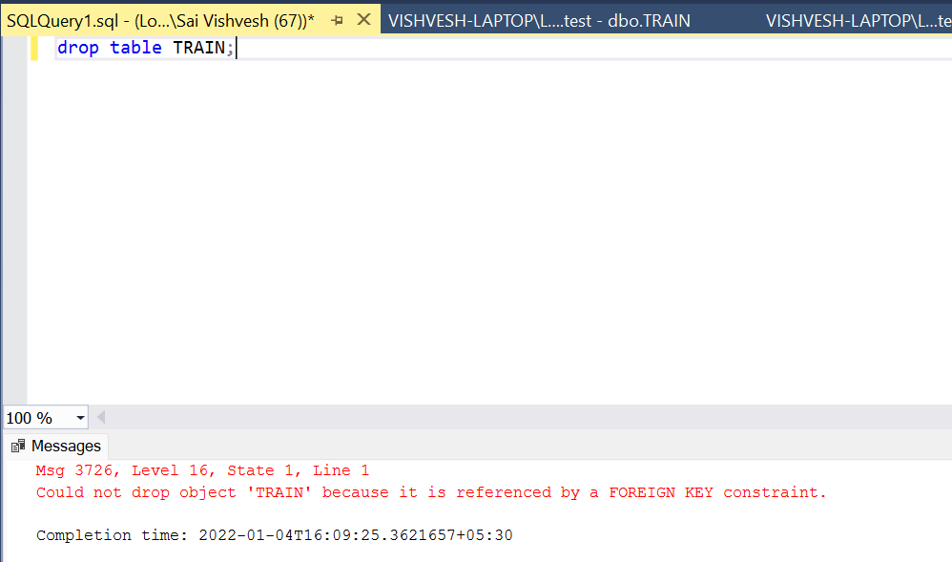

Slide 6
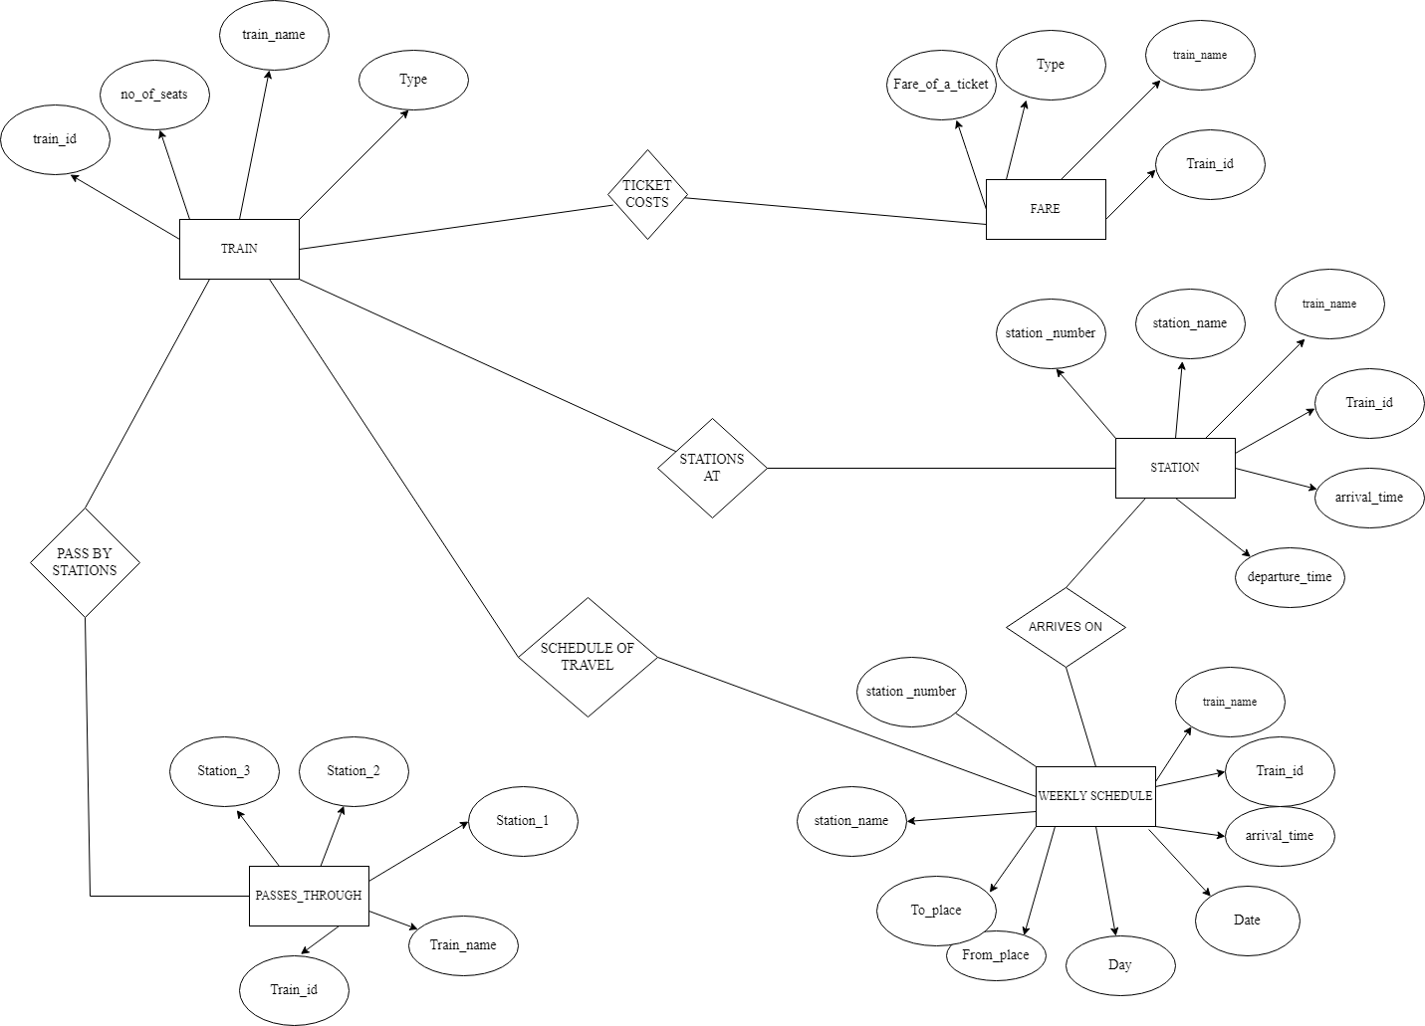
ER DIAGRAM:

Slide 7
SCHEMA DIAGRAM
key | FARE
FK | Train_id int
 | Train_name varchar(20)
 | Type varchar(20)
 | Fare int
key | TRAINS
PK | Train_id int
 | Train_name varchar(20)
 | No_of_seats int
 | Type varchar(20)
 | Days varchar(20)
 | Doj date
 | Time time
 | from_place varchar(20)
 | to_place varchar(20)
 | Station_no int
 | Station_name varchar(20)
key | STATIONS
FK | Train_id int
PK | Station_no int
 | Station_name varchar(20)
 | Train_name varchar(20)
 | Arrival_time time
 | Departure_time time
 | Station_1 varchar(20)
 | Station_2 varchar(20)
 | Station_3 varchar(20)

Slide 8

Schema diagram after normalisation
key | Passes_through
FK | Train_id int
 | Train_name varchar(20)
 | Station_1 varchar(20)
 | Station_2 varchar(20)
 | Station_3 varchar(20)
key | STATION
FK | Train_id int
PK | Station_no int
 | Station_name varchar(20)
 | Train_name varchar(20)
 | Arrival_time
 | Departure_time
KEY | TRAIN
PK | train_id int NOT NULL
 | train_name varchar(20)
 | No_of_seats int
key | WEEKLY_SCHEDULE
FK | Train_id int
FK | Station_no int
 | Train_name varchar(20)
 | Doj date
 | Time_1 time
 | From_place varchar(20)
 | To_place varchar(20)
 | Station_name varchar(20)
PK | Days varchar(20)
Type varchar(15)
key | FARE
FK | Train_id int
 | Train_name varchar(20)
 | Type varchar(20)
 | Fare int

Slide 9
JUSTIFICATION OF NORMALISATION:
1NF - A relation is in 1NF if it contains an atomic value.
2NF - A relation will be in 2NF if it is in 1NF and all non-key attributes are fully functional dependent on the primary key.
3NF - A relation will be in 3NF if it is in 2NF and no transition dependency exists.
HERE IN THE ABOVE DATABASE WE HAVE REDUCED THE TABLES TO THE THIRD NORMAL FORM (3NF).

